Slide 1
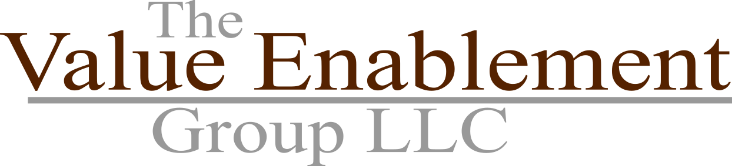
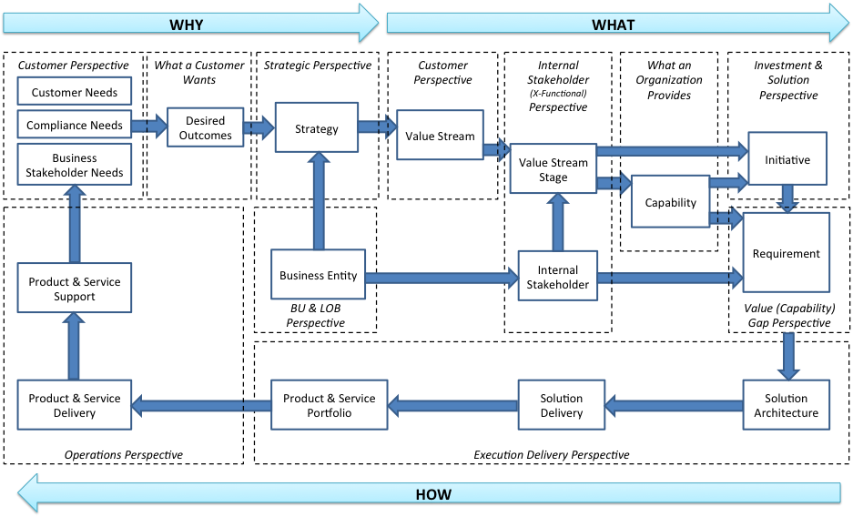
Business Architecture Aligns WHY, WHAT, & HOW across all POVs
Requirements are framed and aligned using business architecture to ensure they address the perspectives (POVs).
When requirements are properly framed, they align strategy and execution to ensure the right value is delivered through the products and services
Business architecture provides a consistent framework for aligning what customers want against what the organization provides as well as driving continuous improvement in value delivery (by closing the right value & capability gaps

Slide 2
Business Architecture Offers Multiple Perspectives on Requirements
Strategic Perspective
Strategy
Investment & Solution
Perspective
Value Stream
Initiative
Value Stream Stage
Capability
Stakeholder Value Perspective
Requirement
Business Unit
What a Business Does
Stakeholder
Organization Perspective
3rd Party & Internal Stakeholder Perspective
Requirements are framed by the strategy they implement, seen through stakeholder value perspective (value stream) and what the business has the ability to do to deliver that value (capability)
Requirements are additionally bound by investment, project and stakeholder focus
Other perspectives for framing, such as product and service, may be exposed using business architecture

